Slide 1
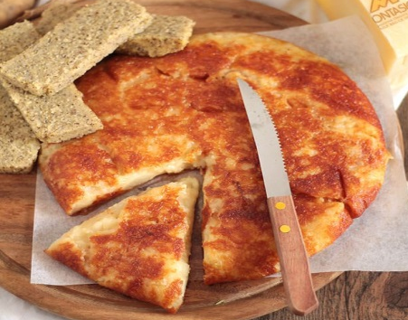
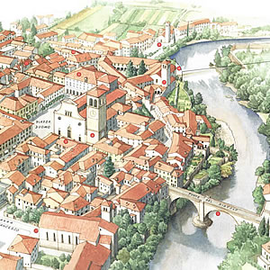
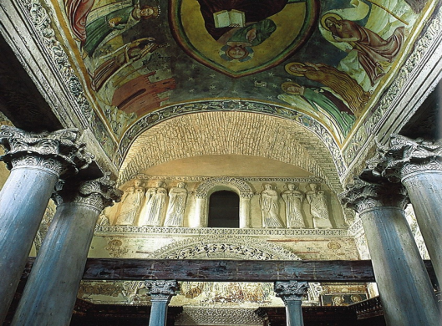
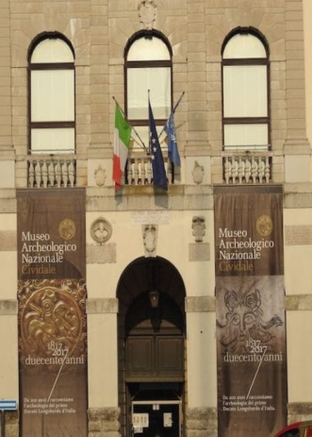
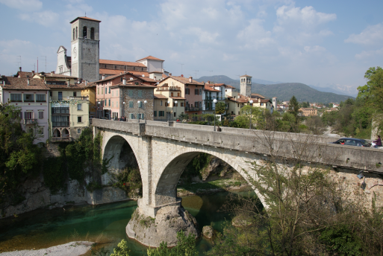
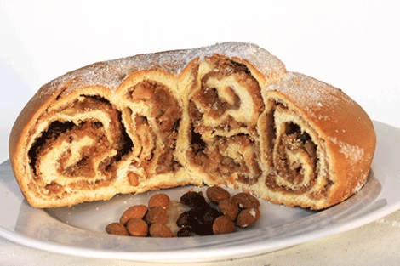
visiting Cividale visiting Cividale visiting Cividale
FRICO
A typical Friuli’s dish made of potatoes, cheese and onions. You can have it with polenta (another typical dish of the region). A delicious frico can be enjoyed in the famous restaurant «Al Monastero» .
THE TEMPLE
The temple is one of the main attractions in Cividale, now a part of a set of buildings recognized by UNESCO world heritage list. It is a landmark of The Longobards in Italy (AD 568-774)
NATIONAL MUSEUM OF ARCHEOLOGY
Founded in 1817, the museum displays the «Altar of Rachtis» and many other Lombard artworks.
Worth a visit!!!
GUBANA
The cake is made of raisins, pinenuts, grappa, and dried fruit. You can taste it at the historical pastry Cattarossi.
DEVIL’S BRIDGE
It was built in 1442. It is made of stone. The legend tells of a Devil, who built the bridge in exchange for the soul of the first creature that would walk on the same bridge.
.

Slide 2
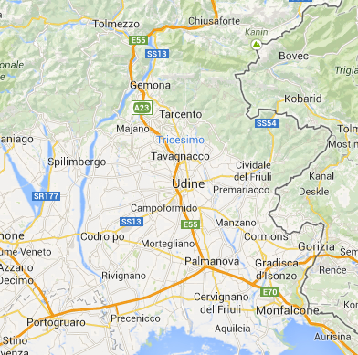
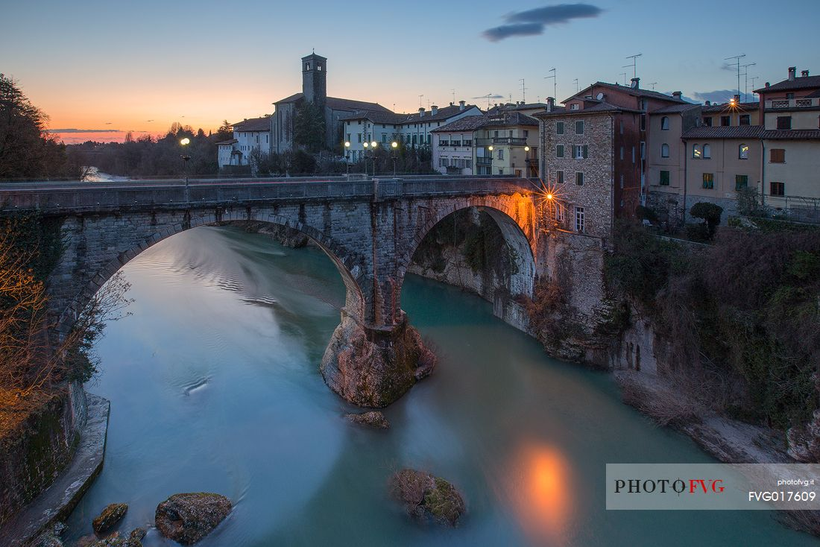
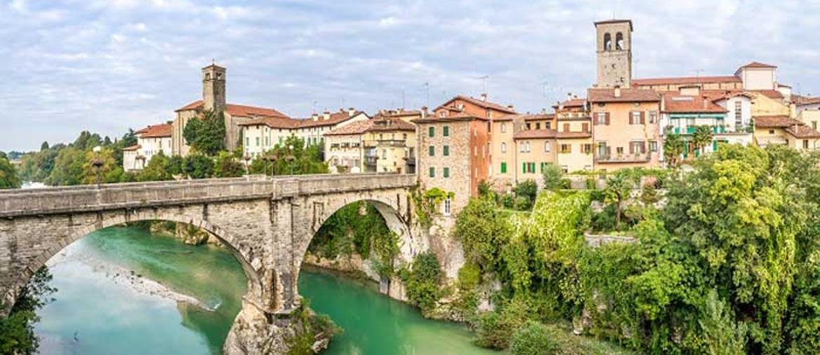
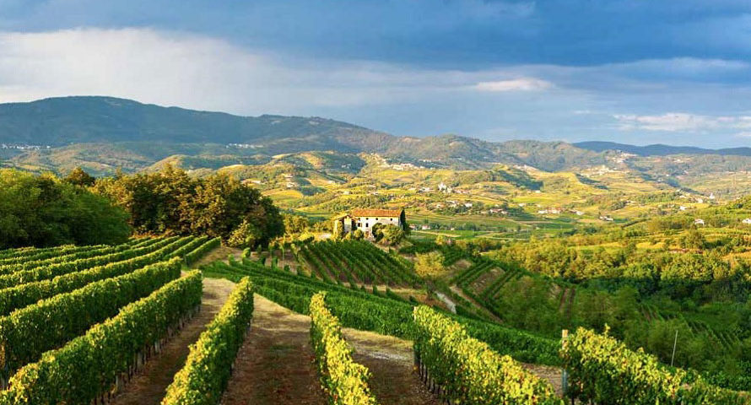
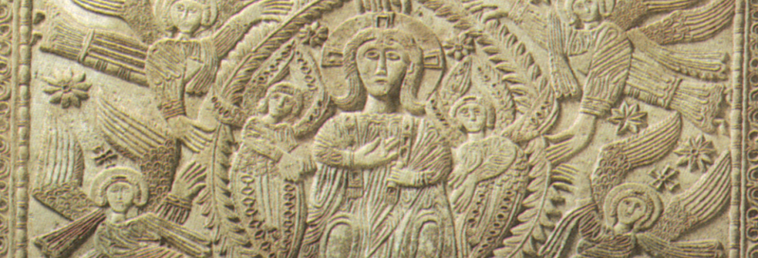
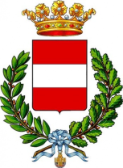
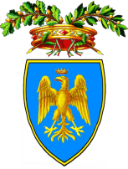
 |  | k
Travelling to Cividale
Cividale is a small town in the North-East of Italy, in Friuli-Venezia Giulia.
By car: close to the A23 (exit Udine North). Cividale is easily accessible from all parts of Friuli.
By rail: Cividale rail station is only 25 minutes drive from Udine. The railway station is a 10 minute walk to the town centre.
By bus: Cividale is well connected with all services to Udine. There is a helpful journey planner at www.saf.ud.it
A DAY-TRIP IN
CIVIDALE

